Slide 1



Slide 2
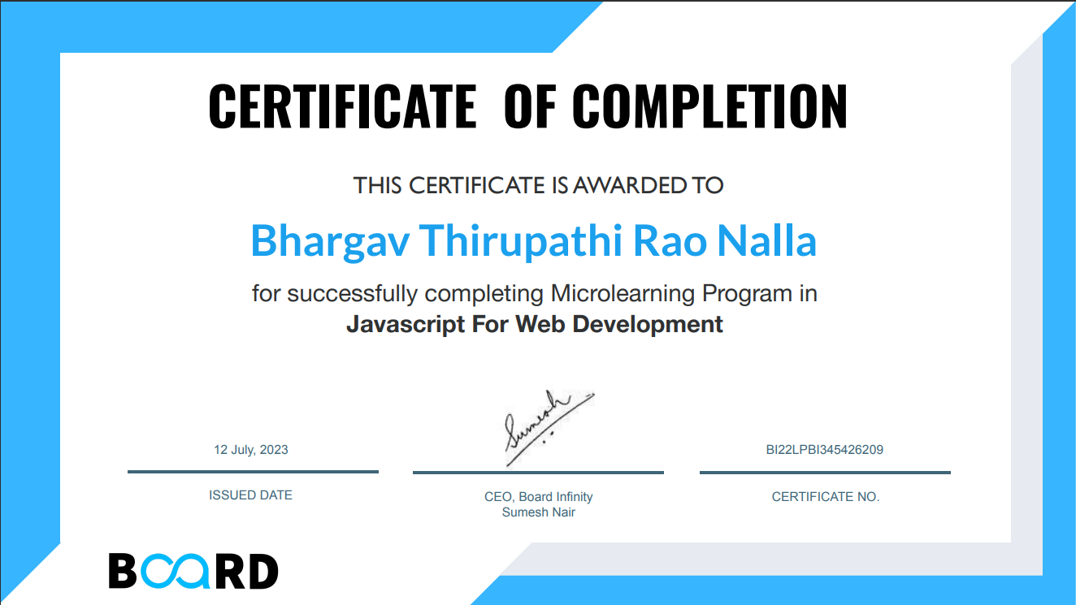
Certificate

Slide 3

Project Title:
Travelling and Tourism
Name of Website
Wandering.com

Slide 4

Travel and Tourism
Summer Training :
“Micro learning in web development”
Introduction:
- "Wandering.com" is a travel and tourism website project with the aim of providing users with a platform for travel exploration.
- The project's primary goal is to inspire and assist travel enthusiasts in planning their dream vacations by offering information and engaging content.
Objectives:
1. Information :
- The project seeks to act as an information hub, offering extensive details about various travel packages, adventure activities, and tourism destinations.
- Users can access in-depth knowledge about their preferred travel options, aiding in informed decision-making.

Slide 5

2.User Engagement:
- The website focuses on user engagement through a user-friendly interface and captivating visuals.
- Interactive features and an intuitive design encourage users to explore the website further, interact with content, and stay engaged.
3.Booking Facilitation:
- The project streamlines the booking process by implementing a contact form where users can make inquiries and bookings.
- A dropdown menu for package selection simplifies the process, making it convenient for users to express their interest.
Scope of Work:
- The project encompasses the creation of a multi-page website with distinct sections, including:
- A home page for initial engagement.
- A dedicated section for adventure ideas.
- Pages for showcasing various travel packages and tours.
- Integration of a contact form for user inquiries and bookings.
- Responsive design principles ensure that the website is accessible and functional across various devices and screen sizes.

Slide 6
Importance and Applicability:
- Significance:
- The project is significant in catering to the interests and aspirations of travel enthusiasts, providing them with a visually appealing and informative platform.
- Applicability:
- The website is applicable to a broad audience, including:
- Individuals seeking travel inspiration.
- Adventure seekers looking for exciting activities.
- Vacation planners in search of packages and tours.
- It serves as a one-stop destination for exploring travel options and initiating booking inquiries.
Role and Profile:
- In the role of a developer:
- Responsibilities included designing the website's structure, ensuring an intuitive and appealing layout.
- Utilized JavaScript to create interactive features that enhance user engagement.
- Implemented CSS to apply styles and layouts consistently throughout the website.
- Ensured the website's responsiveness to cater to users on various devices and screen sizes.
- Curated content to provide accurate and engaging information.
- Developed a user-friendly contact form to facilitate user interaction and inquiries.

Slide 7

Key Elements Used
Event Listeners: Event listeners are used to respond to user interactions. In JS code, I have event listeners for:
#menu-btn: Opens the navigation menu when clicked.
#nav-close: Closes the navigation menu when clicked.
#search-btn: Activates the search form when clicked.
#close-search: Closes the search form when clicked.
window.onscroll: Detects scrolling and adds or removes classes accordingly.
I have used `rem` units in CSS allows for responsive design, making elements adapt well to different screen sizes and maintaining accessibility.
max-width and min-width: I have used max-width and min-width properties within media queries to specify when certain styles should be applied or modified based on the viewport width.
Flexbox Layout: Flexbox (display: flex;) is used in some sections (e.g., .header) to create flexible and responsive layouts, especially for aligning items within the header.

Slide 8

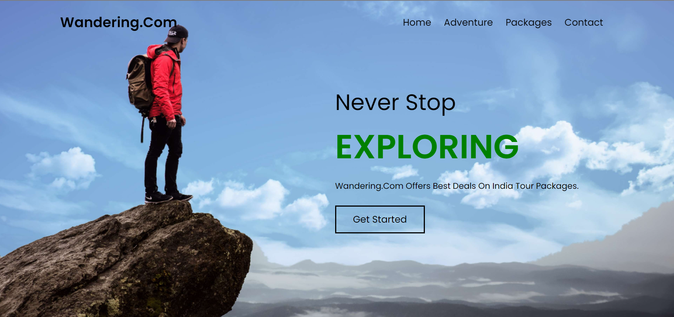
Index Page

Slide 9

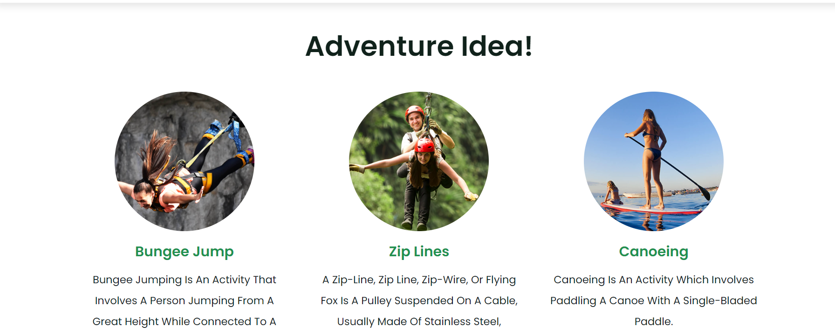

Slide 10
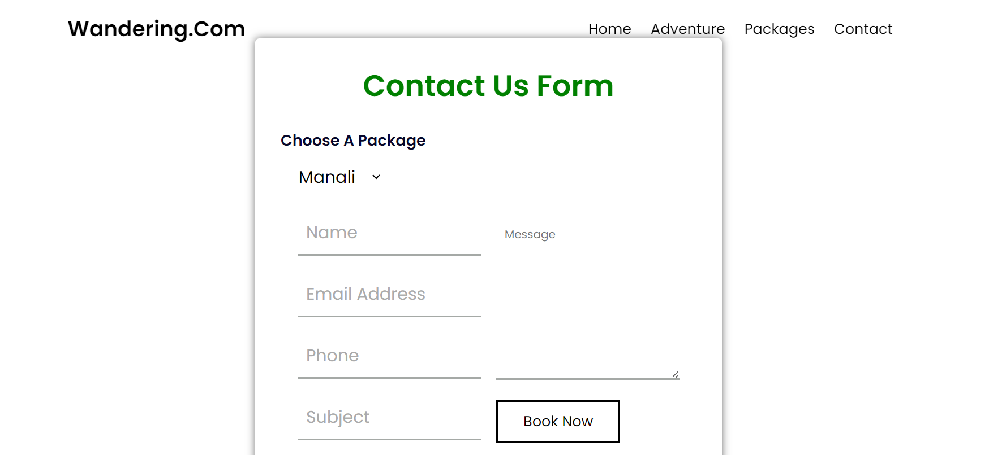
Contact Us Page

Slide 11
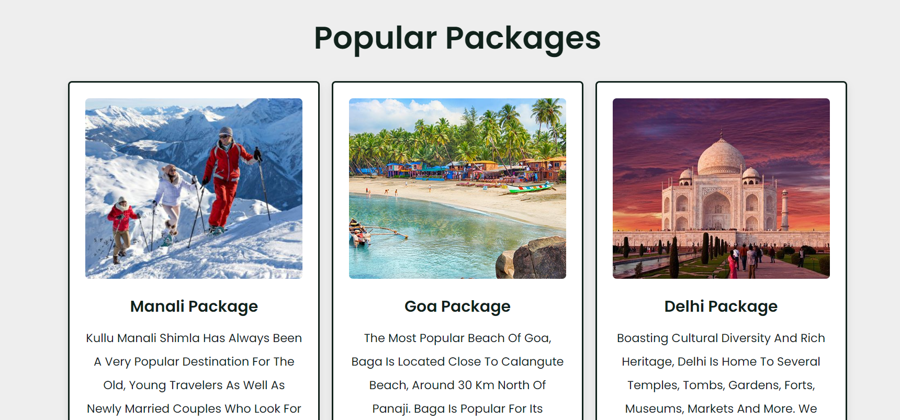
Package Page

Slide 12

The completion of the "Wandering.com" travel and tourism website project marks a significant achievement in the realm of web development and usercentered design. This endeavor aimed to create a digital space that resonates with travel enthusiasts, inspiring them to explore new destinations, engage in exciting adventure activities, and plan their dream vacations. The project's success can be attributed to the fusion of innovative design, interactive features, and comprehensive content that cater to the diverse interests of the target audience.
Concluded With…
GitHub Link: http://Bhargav0326/Travelling-and-Tourism

Slide 13


